Slide 1
Indus valley civilization
Lecturer: no 2
by Ms. Saira Saeed

Slide 2
Indus valley civilization
Indus valley civilization is also known as Harrapan Civilization is the earliest known Urban culture of the Indian subcontinent.
The date of the civilization initiation to be about 2500-1700BCE.
It was a bronze age civilization.
Harappa was firstly excavated in early 20th century during British India. The discovery of Harappa and Mohenjo-Daro was the work begun after the foundation of archeological survey of India.
The cities of ancient Indus were noted for their urban planning, baked brick houses, drainage system, techniques of handicrafts and metallurgy.

Slide 3
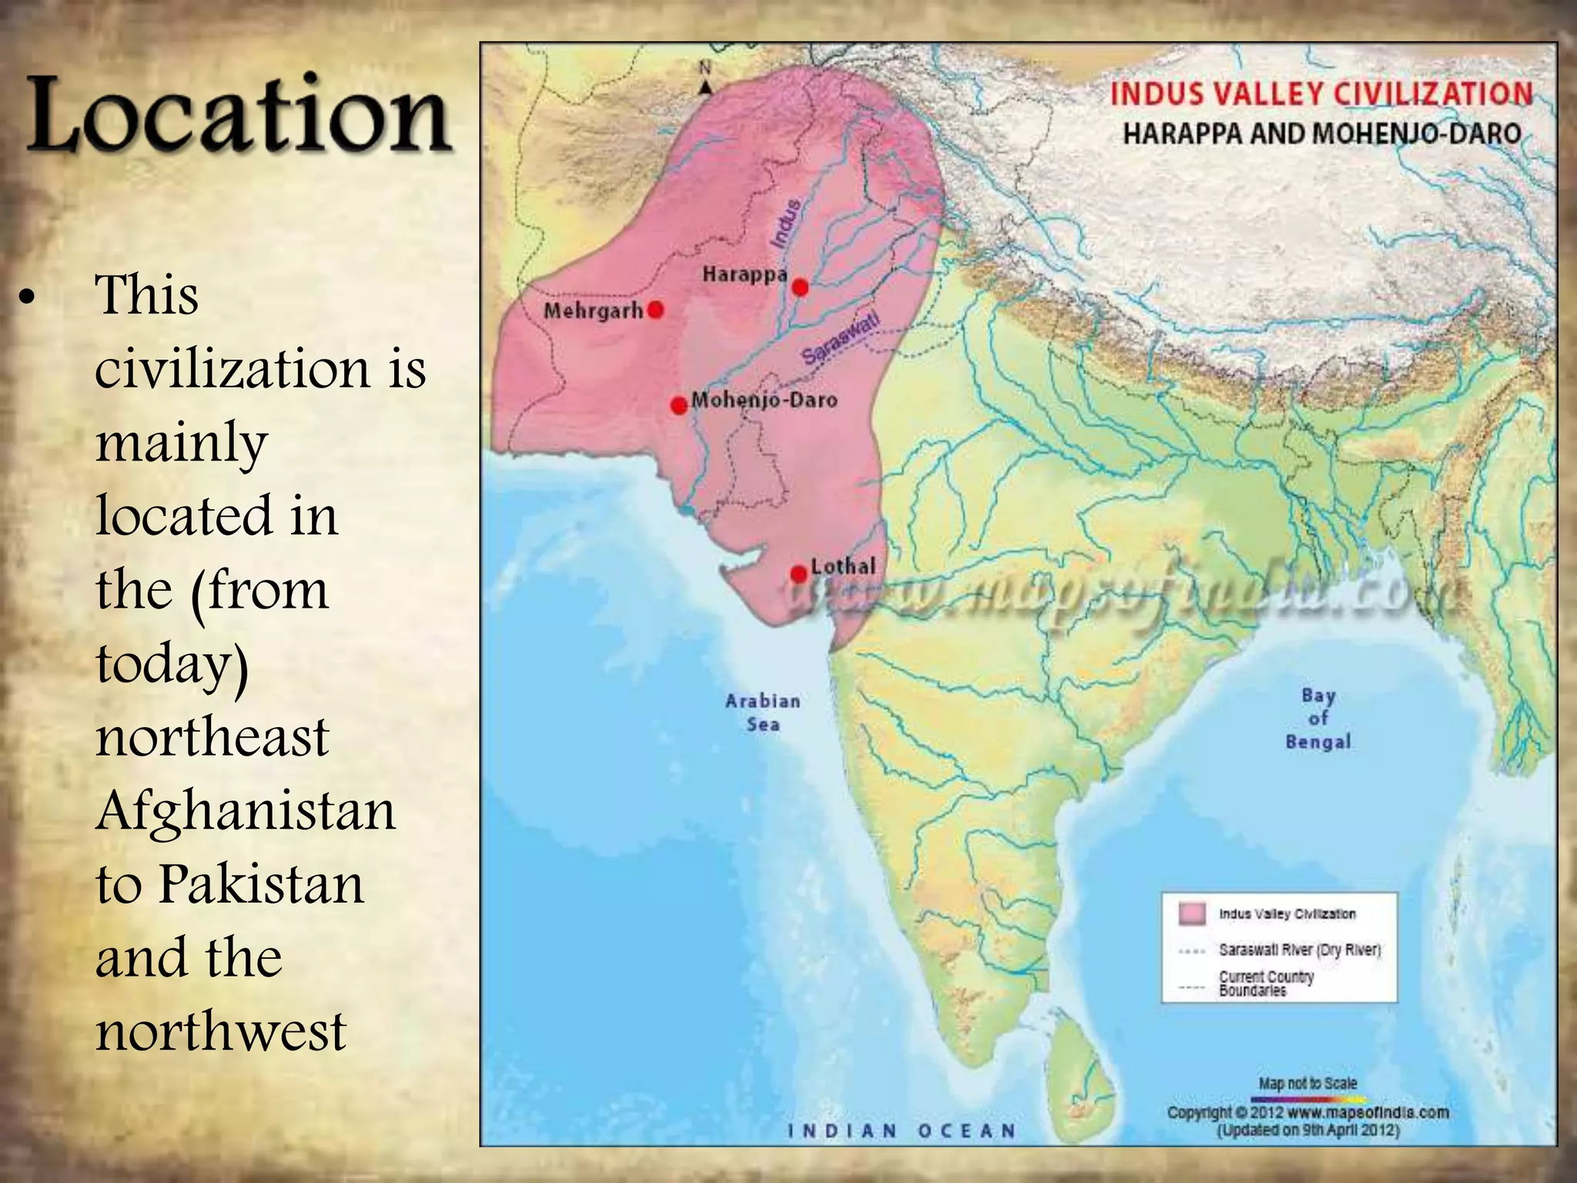

Slide 4
Sir John Marshall characterized the Indus Civilization as Chalcolithic, a period where copper and stone had played vital roles.
The use of stone was limited to grind-stone and vases. Thus in tools, weapons, pottery forms, art objects and house building was dominated by metal techniques and determined the progress of the cities
The whole region was not urbanized but few cities like Mohenjo-Daro and Harappa were the main excavated examples. In both cities, we find same system of writing, same rituals and practices, weight and measures, and this cultural identity suggested the idea of a common political authority.
There are some evidences that proves the existence of large scale businesses, and internal as well as international trade.

Slide 5
Society of Indus valley
Indus valley was not commerce-oriented society. The general pattern was rural, based on farming. Irrigation was provided by flood-water. Different cultures were extended along the river course. The river had provided the lines for transportation and communication, eventually cities also gained control over villages as they did not manufacture what they need, which resulted in the growth of urban centers as industrialized cities and commercial depots where villagers could take their products for sale and exchange.
Both cities represents the significant sites of rural life of bronze age.

Slide 6
Early excavations
Kot Diji was the forerunner of the Indus valley. It dates back in 3300BCE. The remains consists of two parts: the citadel area on high ground and outer area. It was excavated in 1955 and 1957. It is located in the south of Khairpur.
The great civilization was initially identified in 1921 at Harappa than in 1922 at Mohenjo-Daro near Indus river. Its ruins was designated as World Heritage site in 1980. it has more than 100 villages and towns

Slide 7
Pots, toys and figurines
Painted pottery is the only evidence that there was a tradition of painting. The pots were mostly used for storing foods and drink. Some of them were more ornamental rather than practical.
The popular art of the Harappans was in the form of terra-cotta figurines generally agreed as deities.
There are varieties of terra-cotta animals, toys and carts. Best known artifacts are a number of small seals. A majority of seals show a unicorn bull
Copper and bronze were the main metals used for making tools and objects like spears, axes, knives, arrowheads etc.

Slide 8
Drainage system:
The drainage system of Mohenjo-Daro is considered to be way ahead of its time.
It was engineering masterpiece got appreciated when they excavated the site in 1921.
The drainage system was used as a reference to built new cities. The ruins of the sites were found by Sir John Marshall in 1921 for the very time and in 1922 by R.D Banerji. More than 1000cities were found including Harrapa, Mohenjo-Daro, Mehergarh and Ganeri Wala. These were developed urban centers and the buildings were made up of burnt brick and stone. Warehouses, brick walls and granaries also had been proved as great architectural planning. people built there cities with right planning on a definite pattern.

Slide 9
The city structure:
The Indus tribe lived in houses just like today. They were built from bricks and cement and must have been very strong because lots of these buildings are still standing today. All streets and roads were straight, made up of burnt bricks.
Great bath was located inside the city, it was a large rectangular water tank which was meant for special rituals. The walls of tank was coated with gypsum to prevent water leakage.
Most staple food such as rice, wheat and barley were kept for public distribution in storage halls.

Slide 10
Underground drainage system:
There is evidence of very sophisticated drainage system in the cities of Indus valley civilization. The Indus valley’s drainage system was found 4,500 years ago. Cities were equipped with the complex water and sewage system. Rooms, kitchens and bathrooms has drains which were connected with street drains and they were covered with bricks and stone slabs.
Corbelled drains were the main source of collecting sewage and rain water. Trines were the communal areas that contained with one or more toilets.
Drains had holes at regular intervals which were used by for cleaning and inspection.

Slide 11
Decline of the civilization:
The Indus valley civilization started declining from about 1900 BCE.
Changes in climate, decline of trade with Mesopotamians, drying up or flooding of the river, foreign invasion of Indus civilization might have been the reasons for the decline of this civilization.

Slide 12
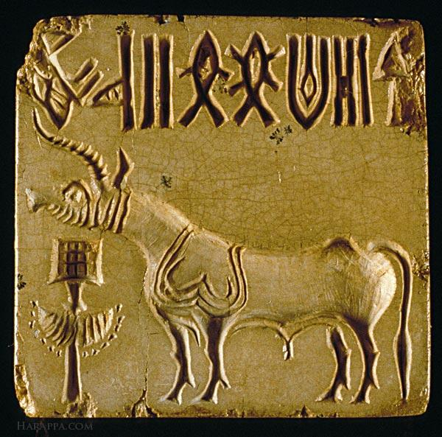
Unicorn Seal of the Indus valley

Slide 13
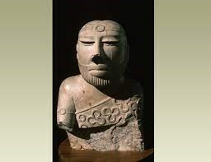
Priest king:

Slide 14
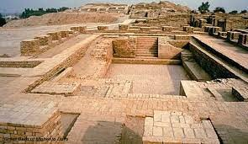
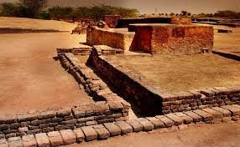
Drainage system and great bath:

Slide 15
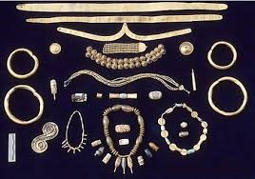
Bronze Jewelry: the Indus valley is rich in many metals and worthy stones such as carnelian, gold copper and turquoise and many others semiprecious stones

Slide 16
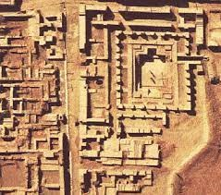
City plan of the valley

